Slide 1
PIP4004 - INTERNSHIP Review-1 Presentation AI-ML Internship at GTRE (DRDO)
Student Details
Name | V SAIPRIYA DIPIKA
Roll No | 20211CSE0178
Section | 8COM-CSE04/ SECTION-15
Batch No. | G-37
Under the Supervision of,
Dr. Sandeep Albert Mathias
Assistant Professor
School of Computer Science and Engineering
Presidency University
Name of the Program: CSE
Name of the HoD: Dr. Asif Mohammed H.B
Name of the Program Project Coordinator: Mr. Amarnath J.L & Dr. Jayanthi. K.
Name of the School Internship/Project Coordinators: Mr. Md Ziaur Rahman /
Dr. Sampath A K / Dr. Abdul Khadar A

Slide 2
Content
About Company or Organization
Working domain or the technology
About your team and reporting Manager
Challenges Faced in Internship
Objectives of the work
Literature Review
Proposed System
Problem Statement
System Requirements
Advantages of Proposed System/Work
Internship Roadmap
Github Link

Slide 3
Defence Research and Development Organisation (DRDO)
Established in 1958, under the Ministry of Defence, India
Responsible for defence R&D to achieve self-reliance in military technology
50+ labs across India working in fields like aerospace, armaments, electronics, and naval systems
Major Products & Technologies:
Missiles: Agni, BrahMos
Combat Vehicles: Arjun Main Battle Tank
Electronic Warfare & Radar Systems
Naval Systems & Submarines
https://www.drdo.gov.in/drdo/
Notes:
BRAHMOS is a universal long-range supersonic cruise missile system that can be launched from land, sea and air.
Agni-1 to 5 missiles are designed & developed by DRDO and inducted into Services to act as deterrence & meet the country’s security requirements.
Arjun MBT offers the troops in the battlefield a state-of-the-art tank with superior firepower, high mobility, and excellent protection
Armaments → military weapons
Aerospace → GTRE
Electronics → Radar and signal processing
Naval → Defense ships, seaplanes, etc

Slide 4
Gas Turbine Research Establishment (GTRE)
Founded in 1959 as Gas Turbine Research Centre (GTRC), became part of DRDO in 1971 and renamed to GTRE
Specialises in aero gas turbine engines for military aircraft
Located in Bangalore, India
Major Products & Technologies:
Kaveri Engine: Indigenous jet engine for fighter aircraft
Marine Gas Turbines for naval applications
Structural & aerodynamic testing and analysis
https://www.drdo.gov.in/drdo/labs-and-establishments/gas-turbine-research-establishment-gtre
Notes:
GTRC In Kanpur, moved to Blr after becoming a part of DRDO
Marine Gas Turbines: Kaveri Marine Gas Turbine engine is a derivative of Kaveri engine developed for Naval ship propulsion. Gas turbine when used in the propulsion system of ship platform

Slide 5
Working domain or the technology
Domain: Artificial Intelligence & Machine Learning (AI/ML) for Performance Analytics
Application: Aero-Gas Turbine Engine Analytics
Technologies:
Machine Learning Models – Detect anomalies & predict failures
Data Visualization – Graph-based analysis of sensor data
Predictive Maintenance – Compare obtained data with ideal benchmarks
Impact: Early fault detection to prevent failures

Slide 6
About your team and reporting Manager
Additional Director (AD)
Technology Director (TD)
Group Director (GD)
Information Technology Group (ITG)
I Report here

Slide 7
Challenges Faced in Internship
Competitive domain
Navigating with limited and restricted access to company data
Specific knowledge of certain libraries/technologies

Slide 8
Objectives of the work
Objective: Develop an AI-driven system to monitor and analyse aero-gas turbine engine performance.
Data collection, preparation, cleaning and preprocessing
UI and API design (if necessary)
AI-Model Design
Scaling and optimization of performance monitoring

Slide 9
Literature Review
Predicting Aircraft Engine Failures using Artificial Intelligence
(Bentaleb, Toumlal and Abouchabaka 2024)
Uses AI to analyze sensor data (temperature, vibration, pressure) for early failure detection.
Machine learning models identify patterns and anomalies to optimize maintenance.
Enhances safety, reliability, and operational efficiency but lacks interactive visualization.
2. A Machine-Learning Approach to Assess Aircraft Engine System Performance
(Tong 2020)
Focuses on ML-based engine health assessment for predictive maintenance.
Uses data-driven modeling to detect trends and optimize maintenance schedules.
Lacks user-driven graph generation and NLP-based interaction for deeper insights.

Slide 10
Literature Review
Enhancing Predictive Maintenance in the Industrial Sector: A Comparative Analysis of ML Models
(Levin 2024)
Compares ML models to identify the most effective predictive maintenance approach.
Reduces downtime and improves fault detection accuracy using AI.
Does not explore interactive visualization or aerospace-specific challenges.
4. Predicting Machine Failures from Multivariate Time Series: An Industrial Case Study
(Vago, et al. 2024)
Uses time-series sensor data to predict failures and improve maintenance strategies.
AI models detect long-term performance deviations and automate alerts.
Lacks user-driven analysis and generative AI for automated insight generation.

Slide 11
Literature Review
5. Advanced ML for Predictive Maintenance: A Case Study on Remaining Useful Life Prediction
(Meddaoui, Hachmoud and Hain 2024)
Focuses on predicting the remaining useful life (RUL) of machinery using ML models.
Helps schedule preventive maintenance and improve operational efficiency.
Does not include interactive analysis or adaptive AI-driven insights.
6. Machine Learning-Based Fault-Oriented Predictive Maintenance in Industry 4.0
(Justus and Kanagachidambaresan 2024)
Introduces a fault-classification framework for Industry 4.0 using ML.
Automates failure detection and optimizes system reliability.
Lacks flexibility for user-defined analysis and visualizations.

Slide 12
Proposed System / Work
AI-Driven Performance Monitoring System:
Data Collection: Sensor data (vibration, temperature, pressure) stored in a database
Data Preprocessing: Cleaning & structuring data for ML models
Graph Generation & Analysis: AI models detect trends, deviations & anomalies
Automated Conclusion Generation: Compares results with ideal benchmarks
Technologies Used:
DBMS for data storage & management
Python & AI Libraries for analysis and UI-Backend integration
Machine Learning Models for anomaly detection

Slide 13
Problem Statement
Title: Performance Monitoring and Analytics for Aero-Gas Turbine Engines
Automate graph analysis & performance evaluation
Compare sensor data with ideal benchmarks
Improve predictive maintenance & fault detection

Slide 14
System Requirements
Hardware Requirements:
High-performance workstation with GPU support
Software Requirements:
DBMS for structured data storage
Python with AI/ML and other Libraries for data analysis and UI-Backend Integration
Visualization tools/Libraries (Matplotlib, Seaborn, etc)

Slide 15
Advantages of Proposed System/Work
Performance Monitoring: Faster detection of performance anomalies
Predictive Maintenance: Prevents failures and reduces downtime
Automated Insights: AI-driven trend analysis & recommendations
User-Driven Visualizations: Dynamic selection of X and Y axes for customized performance analysis.
Scalability & Efficiency: Work with large datasets for accurate performance tracking

Slide 16
Internship Road Map
Review 0
Data collection, preparation, cleaning and preprocessing
Review 1
UI and API design (if necessary)
Review 2
AI-Model Design
Review 3
Scaling and optimization of performance monitoring

Slide 17
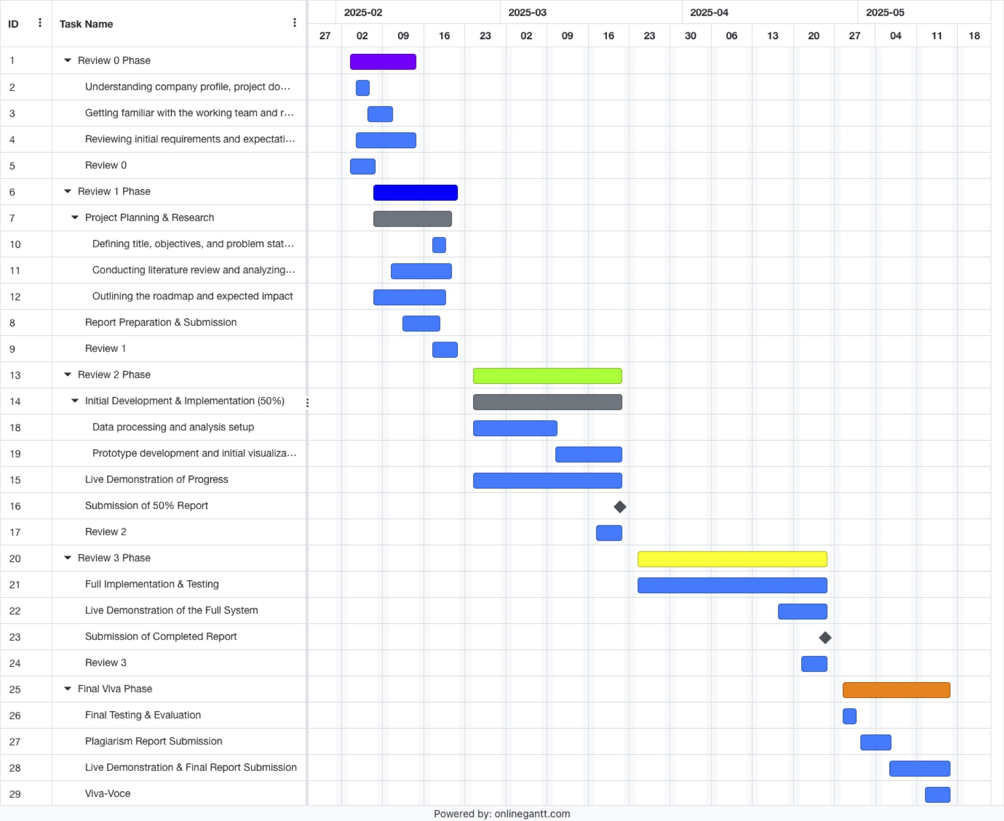
Internship Road Map: Gantt Chart

Slide 18
Github Link
https://github.com/saipriya-dipika/AI-ML-Internship

Slide 19
References
BENTALEB, Asmae, Kaoutar TOUMLAL, and Jaafar ABOUCHABAKA. "Predicting Aircraft Engine Failures using Artificial Intelligence." International Journal of Advanced Computer Science & Applications 15, no. 2 (2024)
Tong, Michael T. "A Machine-Learning Approach to Assess Aircraft Engine System Performance." In Turbo Expo: Power for Land, Sea, and Air, vol. 84058, p. V001T01A022. American Society of Mechanical Engineers, 2020.
Levin, Semen. "Enhancing predictive maintenance in the industrial sector: A comparative analysis of machine learning models." In AIP Conference Proceedings, vol. 3243, no. 1. AIP Publishing, 2024.
Pinciroli Vago, Nicolò Oreste, Francesca Forbicini, and Piero Fraternali. "Predicting Machine Failures from Multivariate Time Series: An Industrial Case Study." Machines 12, no. 6 (2024): 357.

Slide 20
References
Meddaoui, Anwar, Adil Hachmoud, and Mustapha Hain. "Advanced ML for predictive maintenance: a case study on remaining useful life prediction and reliability enhancement." The International Journal of Advanced Manufacturing Technology 132, no. 1 (2024): 323-335
Justus, Vivek, and G. R. Kanagachidambaresan. "Machine learning based fault-oriented predictive maintenance in industry 4.0." International Journal of System Assurance Engineering and Management 15, no. 1 (2024): 462-474.

Slide 21
Q&A

Slide 22
Thank you !!

